Slide 1
Chapter 4 Control structure
Thanh-Sach Le

Slide 2
Content
Application and usage of control structure
Statements and program
If statement
If-else statement
Nested if-else
Switch-case statement
Enumeration and switch-case
Conclusion

Slide 3
Application and usage of control structure

Slide 4
Application and usage of control structure
All useful applications in real life use control structure
Example 1: Input a date (including, they day, month and year).
A well-made program MUST CHECK if the inputted date is valid or not. One must not assume that the date entered by user is always in our expected domain.
To check if the inputted month is valid, it’s possible that the following structure was used:
if ( (month < 1) hoặc (month > 12) )
Handle invalid month error
endif

Slide 5
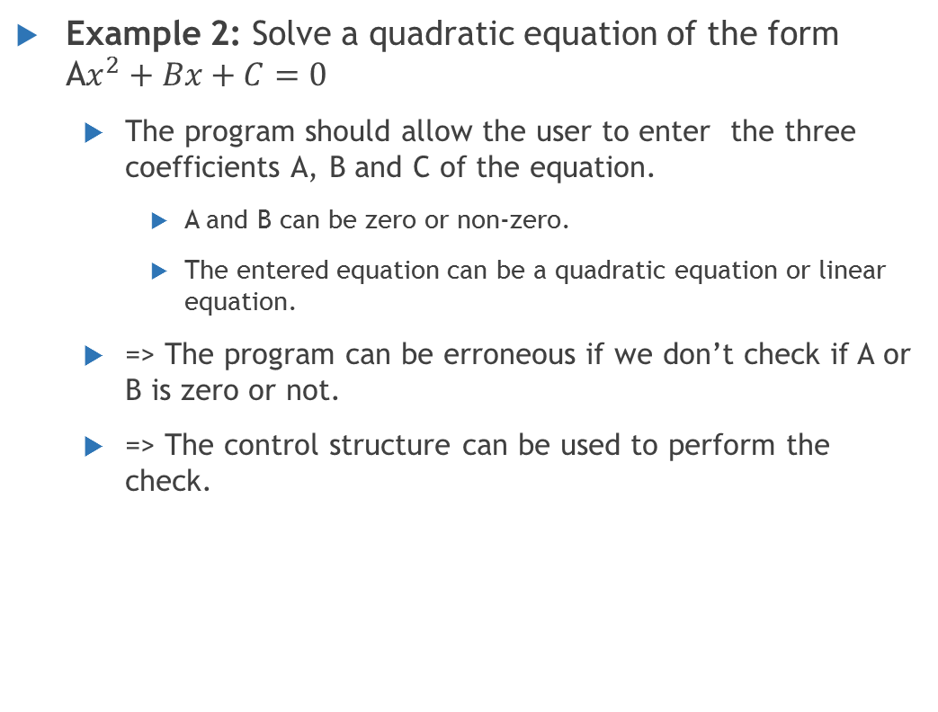
Application and usage of control structure
Example 2: Solve a quadratic equation of the form A$x^{2}+Bx+C=0$
The program should allow the user to enter the three coefficients A, B and C of the equation.
A and B can be zero or non-zero.
The entered equation can be a quadratic equation or linear equation.
=> The program can be erroneous if we don’t check if A or B is zero or not.
=> The control structure can be used to perform the check.

Slide 6

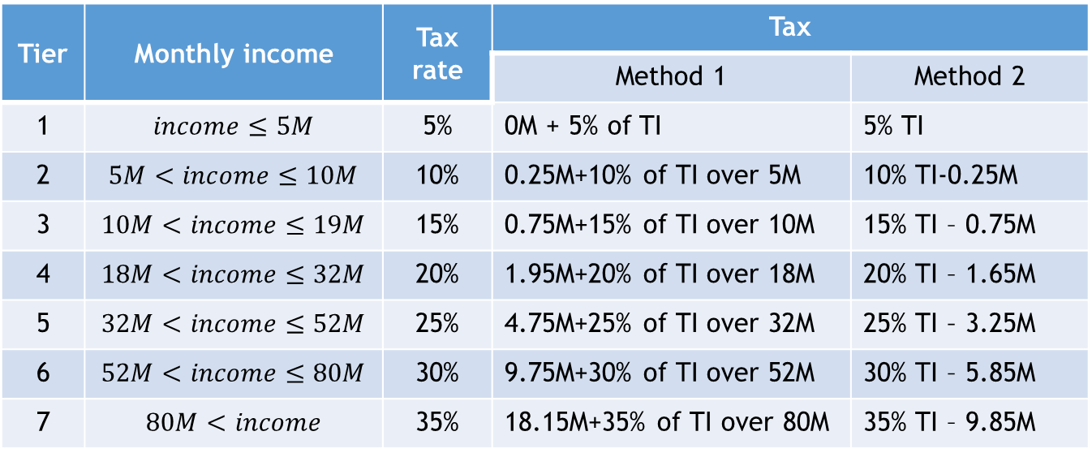
Application and usage of control structure
Example 3: Find the tax rate of an individual in accounting
The tax table in 2016 is as follow:
Tier | Monthly income | Tax rate | Tax
 |  |  | Method 1 | Method 2
1 | $$income≤5M$$ | 5% | 0M + 5% of TI | 5% TI
2 | $$5M<income≤10M$$ | 10% | 0.25M+10% of TI over 5M | 10% TI-0.25M
3 | $$10M<income≤19M$$ | 15% | 0.75M+15% of TI over 10M | 15% TI – 0.75M
4 | $$18M<income≤32M$$ | 20% | 1.95M+20% of TI over 18M | 20% TI – 1.65M
5 | $$32M<income≤52M$$ | 25% | 4.75M+25% of TI over 32M | 25% TI – 3.25M
6 | $$52M<income≤80M$$ | 30% | 9.75M+30% of TI over 52M | 30% TI – 5.85M
7 | $$80M<income$$ | 35% | 18.15M+35% of TI over 80M | 35% TI – 9.85M
$M:$ million VND, TI: taxed income

Slide 7
Application and usage of control structure
Example 4: Implement the interaction between a user and a software (may have graphics interface or may not)
The program must listen to all sort of events occurring in a software
With graphics interface: left mouse, right mouse, middle mouse, menu A chosen, menu B chosen, etc.
On console: the ID of a task (number, string) entered.
The program must execute all different tasks based on what event/ID was chosen by the user.
We need control structure (preferably switch because there are a lot of cases)

Slide 8
Statements and program
What is a statement?
Is a programming line written by a programming language.
In C++, the end of a statement is marked with a semi-colon (;), similar to the usage of the dot symbol in natural language (.).
Types of statement:
Single statement, consists of simple statements:
Variable declaration.
Assignment statement.
Function call.
Etc.

Slide 9
Statements and program
Types of statement:
Single statement.
Composite statement, a list of statements to be executed together, sandwiched by a pair of curly braces { and }:
The control statements: if, if-else, switch, for, while, do-while, etc. are considered composite statements.
{
<statement 1>
<statement 2>
//...
}

Slide 10
Statements and program
Types of statement:
Single statement.
Composite statement.
Empty statement:
Only has the semi-colon (;) at the end.
It is allowed in C++ but not usually used.

Slide 11
Statements and program
Program
A program can be considered an ordered sequence of statements:
Each of them can be a single statement or a composite statement (including control statement and loop statement)
The computer will execute each statement, one by one from first statement to the last one.
This way of controlling a program is called sequential execution.
Two another ways of controlling the flow of a program:
Branching statements: if, if-else, switch.
Loop statements: for, while, do…while.

Slide 12
The if statement - concept
false
<boolean expression>
<conditional statement>: A boolean expression or an expression convertible to a boolean expression
<statement>: a single statement or a composite statement
true
<statement>

Slide 13
The if statement - concept
false
Execution of the if statement:
The boolean expression is evaluated
If the evaluation result is true then the program will run <statement>. Otherwise, the program will run the statements after if
<boolean expression>
true
<statement>

Slide 14
The if statement - syntax
if (<boolean expression>) <statement>
if (<boolean expression>) { <statement>
//can add more statements
}
if (<boolean expression>)
<statement>
if (<boolean expression>)
{ <statement>
//can add more statements
}

Slide 15
The if statement – syntax + coding style
if (<boolean expression>) <statement>
if (<boolean expression>) { <statement>
//can add more statements
}
if (<boolean expression>)
<statement>
if (<boolean expression>)
{ <statement>
//can add more statements
}
TAB
TAB

Slide 16
The if statement
Example: verifying if a date (including month and year) is valid
if( (month <= 0) || (month > 12) )
exit(1);
The program will end if the month is invalid

Slide 17
The if statement
Example: verifying if a date (including month and year) is valid
Instead of terminating the program, we can also assign the date to be a default date:
if( (month <= 0) || (month > 12) ){
date = 1;
month = 1;
year = 1970;
}

Slide 18
The if statement
Example: verifying if a date (including month and year) is valid
Instead of terminating the program, we can also assign the date to be a default date:
It is not logically correct to write the above block without the curly braces. The above block means that the month and the year will always be assigned to 1 and 1970 regardless of the month being invalid or not.
if( (month <= 0) || (month > 12) )
date = 1;
month = 1;
year = 1970;

Slide 19
The if-else statement - concept
false
<boolean expression>
<conditional statement>: A boolean expression or an expression convertible to a boolean expression
<statement T>, <statement F>: a single statement, a composite statement or an empty statement
true
<statement T>
<statement F>

Slide 20
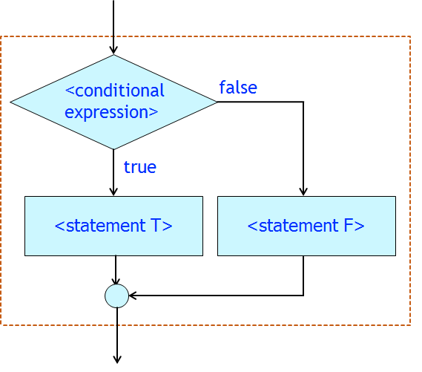
The if-else statement - concept
Execution of the if-else statement:
The boolean expression is evaluated
If the evaluation result is true then the program will run <statement T>. Otherwise, the program will run <statement F>. The program will execute the statement after if-else when <statement T> or <statement F> is done.

Slide 21
The if-else statement - syntax
if (<boolean expression>) <statement T>
else
<statement F>
if (<boolean expression>) <statement T>
else <statement F>
Note: <statement T> and <statement T> must end with ;

Slide 22
The if-else statement – syntax + coding style
if (<conditional statement>) <statement T>
else
<statement F>
if (<boolean expression>) { <statement when true>
//...
<statement when true>
}
else{
<statement when false>
//...
<statement when false>
}

Slide 23
The if-else statement – syntax + coding style
if (<conditional statement>) <statement T>
else
<statement F>
if (<boolean expression>) { <statement when true>
//...
<statement when true>
}
else{
<statement when false>
//...
<statement when false>
}
TAB
TAB

Slide 24
The if-else statement – syntax + coding style
if (<boolean expression>) <statement T>
else <statement F>
This should only be used if both are simple statements

Slide 25
The if-else statement
Solving quadratic equation
Analysis:
The user needs to enter 3 coefficients: A, B and C
Therefore:
A, B: can be 0.
The equation can become a linear equation or zero-degree equation.
There are three cases to check.

Slide 26
The if-else statement
Solving quadratic equation
Analysis:
The three cases are:
(1) Zero-degree, A = 0 and B = 0:
Use C to check if there are no solution or infinitely many solutions.
(2) First-degree (linear), A = 0 but B != 0:
Solve a linear equation.
(3) Second-degree (quadratic), A != 0:
Solve a quadratic equation.

Slide 27
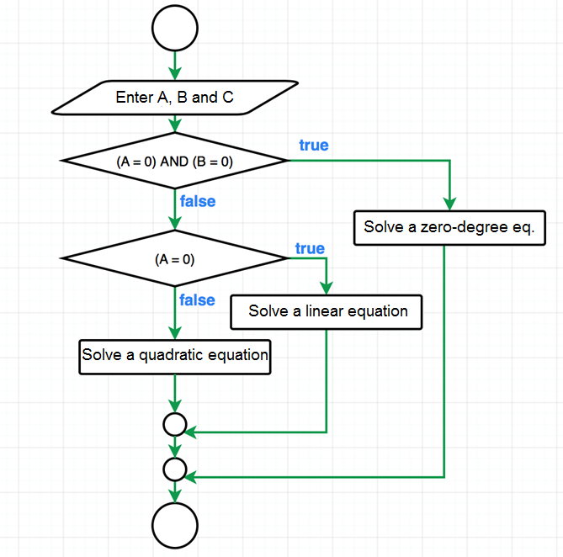
We need to analyze more on how to solve each type of equation

Slide 28
The if-else statement – Example
Solving quadratic equation
#include <iostream>
using namespace std;
int main(){
float a, b, c, delta;
cout << “Enter a, b, c: \n";
cin >> a >> b >> c;
delta = b*b - 4*a*c;
if(delta < 0)
printf(“There is no solution\n");
else
printf(“There are at least one solution\n");
return 0;
}

Slide 29
Nested if-else statement – Application
Most of the useful applications in real life does not consist of only simple, separate cases (sequential).
The applications must also check nested conditions.
Example: solving quadratic equation:
If A and B are zero:
The program must then check if C is 0 or not.
If C = 0, the equation has infinitely many solutions.
If not, the equation has no solution.

Slide 30
Consider two cases: no solution and infinitely many solutions. They are nested in a parent conditional structure:
Check if (A=0) AND (B=0)

Slide 31
Nested if-else statement – Application
Problem: calculate the letter grade of each student according to their numerical scores
There are 5 letter grades:
F (fail): grade lies in the [0, 5) interval
D: grade lies in the [5, 6.5) interval
C: grade lies in the [6.5, 8) interval
B: grade lies in the [8, 9.5) interval
A: grade lies in the [9.5, 10] interval

Slide 32
Nested if-else statement – Application
Input: score
false
false
false
false
Score < 5
Score < 6.5
Score < 8
Score < 9.5
true
true
true
true
LG = “B”
LG = “A”
LG = “C”
LG = “D”
LG = “F”
Output: LG (letter grade)

Slide 33
Nested if-else statement – Application
Input: score
false
false
false
false
Score < 5
Score < 6.5
Score < 8
Score < 9.5
true
true
true
true
LG = “B”
LG = “A”
LG = “C”
LG = “D”
LG = “F”
Output: LG (letter grade)
These are nested in the “(Score < 5) is false” scope.

Slide 34
Nested if-else statement – Syntax There are many representations
if (<boolean expression 1>) <statement 1>
else if (<boolean expression 2>) <statment 2>
else if (<boolean expression 3>) < statement 3>
else <statement 4>
if (<boolean expression 1>)
<statement 1>
else if (<boolean expression 2>)
<statement 2>
else if (<boolean expression 3>)
<statement 3>
else
<statement 4>

Slide 35
Nested if-else statement – Syntax There are many representations
if (<boolean expression 1>) <statement 1>
else if (<boolean expression 2>) <statment 2>
else if (<boolean expression 3>) < statement 3>
else <statement 4>
if (<boolean expression 1>)
<statement 1>
else if (<boolean expression 2>)
<statement 2>
else if (<boolean expression 3>)
<statement 3>
else
<statement 4>

Slide 36
Nested if-else statement - Example
#include <iostream>
using namespace std;
int main(){
float score = 8.7f;
if(score < 5.0f)
cout << “F";
else if(score < 6.5f)
cout << “D";
else if(score < 8.5f)
cout << “C";
else if(score < 9.5f)
cout << “B";
else
cout << “A";
return 0;
}
Coding style:
Same tab space

Slide 37
Nested if-else statement - Example
Coding style:
Same tab space
(when pairs of curly braces { } are used)
if(score < 5.0f){
cout << “F";
}
else if(score < 6.5f){
cout << “D";
}
else if(score < 8.5f){
cout << “C";
}
else if(score < 9.5f){
cout << “B";
}
else{
cout << “A";
}

Slide 38
Switch-case statement – Application
When a program has a list of tasks to be executed according to known cases (events).
The number of tasks: countable.
The number of events: countable.
Example: book management.
The program provides an interface for the user to
Read data from file
Enter data to the program
Find a book
Retrieve a list of borrowers with overdue books
Etc.
The number of tasks listed is finite.

Slide 39
Switch-case statement – Application
Example: book management.
The program can print a list of tasks from which the user choose:
Graphics interface: display graphical indicators, buttons, etc. instead of printing on a console.
When user chooses a menu:
The program performs the task corresponding to the chosen menu.
Each task is executed depending on a specific event.
Suitable for switch-case.

Slide 40
Switch-case statement – Concept
false
false
false
<case 1>
<case 2>
<case N>
true
true
true
<statement 1>
<statement 2>
<statement N>
<default>

Slide 41
Switch-case statement – Concept
How switch-case works:
The program checks which case is triggered among all listed cases: <case 1>, <case 2>, .., <case N>
If the i-th case is triggered (I = 1 .. N):
Execute every statements from i to N (<statement i> to <statement N>), including <default>
If the current statement is break; the program will step out of the switch-case scope structure and jump into the next statement right after switch-case.
If none of the case was triggered:
The program will execute <default> and step out of switch-case.

Slide 42
Switch-case statement – Syntax
switch (<eventID>){
case <ID 1>: <statement 1>
case <ID 2>: <statement 2>
case <ID N>: <statement N>
default: <default statement>
}
switch, case, default: keywords
<eventID>:
MUST BE an expression of the following types:
(1) integral or enumeration type, or
(2) a class type contextually implicitly convertible to an integral or enumeration type (through typedef)
<ID i>: (i=1,.., N), possible values of eventID

Slide 43
Switch-case statement – Syntax
switch (<eventID>){
case <ID 1>:
case <ID 2>:
case <ID 3>: <statement 3>
case <ID N>: <statement N>
default: <default statement>
}
If statement 1, 2 and 3 are similar, we can types as above so that <statement 3> can be used for all three cases 1, 2 and 3.

Slide 44
Switch-case statement – Syntax
switch (<eventID>){
case <ID 1>: <statement 1> break;
case <ID 2>: <statement 2>
case <ID N>: <statement N>
default: <default statement>
}
After <statement 1> is done, the program will step out of the above switch-case, the rest of the statements (2 to N) are skipped.

Slide 45
Switch-case statement – Syntax
switch (<eventID>){
case <ID 1>: <statement 1> break;
case <ID 2>: <statement 2> break;
case <ID N>: <statement N> break;
default: <default statement>
}
In this switch-case, only one of the statement will be executed.

Slide 46
Switch-case statement – Syntax
switch (<eventID>){
case <ID 1>: <statement 1> break;
case <ID 2>: <statement 2> break;
case <ID N>: <statement N> break;
}
In this switch-case, only one of the statement will be executed.
No default statement.

Slide 47
Switch-case statement – Example
Problem:
The program receives a choice from user.
A choice can be either 1 or 2.
The numbers (1 and 2) are not tied to any specific event at the time.
Print the choice of the user.
In the future, instead of printing the choice, we can just replace the printing with the actual codes of a specific event tied to the corresponding ID number.

Slide 48
Switch-case statement – Example
#include <iostream>
using namespace std;
int main(){
int choice;
cout << “Enter the choice: \n“;
cin >> choice;
switch (choice){
case 1:
cout << "Case 1\n"; cout << "Task 1\n");
case 2:
cout << "Case 2\n"; cout << "Task 2\n");
default:
cout << “Default task\n";
}
return 0;
}

Slide 49
Switch-case statement – Example
The program might print bot tasks
Because there is no break;
#include <iostream>
using namespace std;
int main(){
int choice;
cout << “Enter the choice: \n“;
cin >> choice;
switch (choice){
case 1:
cout << "Case 1\n"; cout << "Task 1\n");
case 2:
cout << "Case 2\n"; cout << "Task 2\n");
default:
cout << “Default task\n";
}
return 0;
}

Slide 50
Switch-case statement – Example
break: makes it so that only
The chosen task will be printed
#include <iostream>
using namespace std;
int main(){
int choice;
cout << “Enter the choice: \n“;
cin >> choice;
switch (choice){
case 1:
cout << "Case 1\n"; cout << "Task 1\n"); break;
case 2:
cout << "Case 2\n"; cout << "Task 2\n"); break;
default:
cout << “Default task\n";
}
return 0;
}

Slide 51
Switch-case statement – Example
Another example for menu:
Enumeration type (enum) can be used.

Slide 52
Enumeration and switch-case
#include <iostream>
#include namespace std;
enum choice {Agree, Disagree, Undecided};
int main(){
enum Luachon luachon;
cout << "Enter your choice \n";
cout << "0. Agree \n";
cout << "1. Disagree \n";
cout << "2. Haven’t decided \n";
cin >> choice;
switch (choice){
case Agree: cout << "You agreed\n"); break;
case Disagree: cout << "You disagreed\n"; break;
case Undecided: cout << "You haven’t decided\n"; break;
default: cout << "Your choice was invalid\n";
}
return 0;
}

Slide 53
Switch-case statement – Exercise
Problem: product management
The program has the following features:
Allow user to enter product
Save product
Read products from file
Etc.
The program must print a menu from which the user will choose what to do (choice is entered through a keyboard).
For each choice:
Print the chosen task
Students will have to implement all of these tasks further in the course

Slide 54
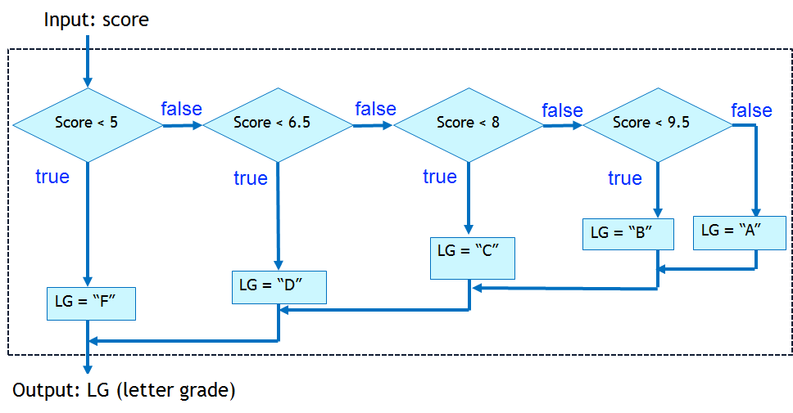
Comparing if-else and switch-case
Why didn’t we use switch-case for the grading problem?
=> Because the scores are not integral or enumeration data type.

Slide 55
Comparing if-else and switch-case
Switch-case statement can always be replaced as a sequence of if-else statements.
For some situations, switch-case is more readable.
All control structures can be represented by if-else and the statement goto (with the help of labels)

Slide 56
Conclusion
Students should be able to decompose a problem into smaller ones to solve it:
Refer to the quadratic equation examples and the others.
Understand and is able to apply the control statements provided in C++:
The logic behind conditional/branching execution.
if-else statement and nested if-else statements.
switch-case statement.

